Slide 1

22nd January 2024
REA Green Gas Forum meeting
@REAssociation

Slide 2
Agenda
Green Gas Forum Meeting
@REAssociation

Slide 3
REA Organics update
Sara Bartle
@REAssociation

Slide 4
Organics Update
Simpler Recycling
Quality Protocol revision
Other updates
  Scottish Environmental Authorisation Consultation
  Standard rule permits
  NRW nutrient planning and digestate storage
  Preventing agricultural pollution from slurry
@REAssociation

Slide 5
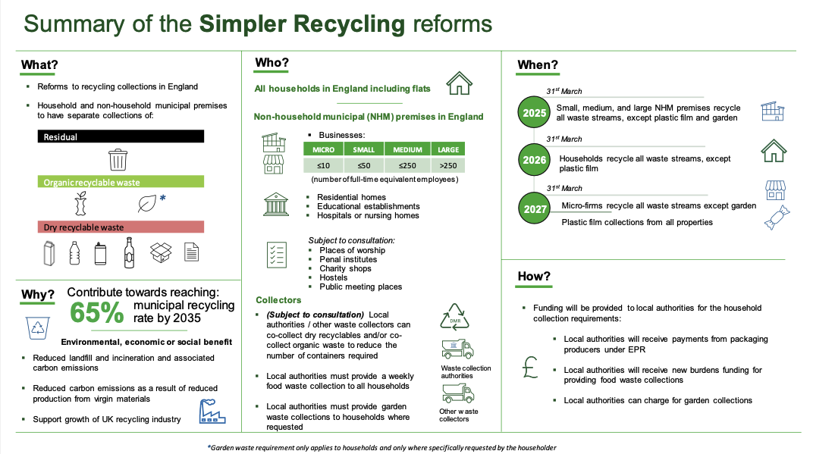
Simpler Recycling
Slide from Defra
@REAssociation

Slide 6
Quality Protocols Update
AD Quality Protocol
Republished as Resource Frameworks
Amended appendix B list of waste feedstocks
Proposed tighter plastics limits – to be agreed
  8% of current PAS110 limits
  2 year transition
Update of risk assessment
Manure and slurry derived digestates
Biomethane QP
Call for evidence and response submitted
@REAssociation

Slide 7
Other topics
Scottish Environmental Authorisation Consultation
  Regulation of sewage sludge and non-waste AD
Standard Rule Permit for capture of biogas from lagoons and tanks
EA planning review of standard rules permits and guidance
NRW looking at nutrient planning and digestate storage
Defra - Prevention of agricultural pollution from slurry (including digestate)
@REAssociation

Slide 8
Forthcoming Events
Understanding PAS110 in full, 27-28th February
Organics Conference, 21st March 2024
Member meeting on Scottish Environment Authorisation Consultation - TBC
@REAssociation

Slide 9
REA Transport and renewable fuels update
Paul Thompson
@REAssociation

Slide 10
Biomethane deployment in RTFO
In 2022:
73Ml eq of CNG, 54Ml eq LNG supplied - up 12% from 2021. 1kg biomethane=1.9litre
Biomethane was 3.8% of all renewable fuels supplied (0.26% of all road fuels)
Vast majority of feedstocks wastes or residues. Average GHG saving 86-90%
Feedstock from UK and 12 other European countries
2023 data not yet available in full, but growth appears to be continuing
@REAssociation
Notes:
90% the reported av number for LNG, 86% for CNG
Nov 23 dataset has 77ml eq CNG and 43ml eq LNG – ie close to the full year amount for 2022. Final data will only be published in Nov 24
Other European countries: Austria, Belgium, Czech Republic, Denmark, France, Germany, Hungary, Ireland, Netherlands, Slovakia, Spain, Sweden
Figures are volume of fuel, not certificates (ie excluding double counting)
No biomethane development fuel
Total renewable fuel = 3325Ml
Total all fuel = 48,653 Ml
RFTO Biomethane Guidance 2023 (publishing.service.gov.uk)
Renewable Transport Fuel Obligation: Compliance Guidance 2024 (publishing.service.gov.uk)

Slide 11
RTFO policy development
Low Carbon Fuels Strategy still not yet published
DfT expects to publish a review of changes made in 2018 – these include introduction of development fuels sub-target and separate GHG reporting
On the back of responses to the review, DfT will develop proposals for future shape of RTFO – may be something for 2024, given timing of general election
@REAssociation

Slide 12
Sustainable Aviation Fuel (SAF)
DfT intends to introduce a SAF mandate in 2025, using same legal basis as RTFO
Obligation will be on suppliers of aviation fuel for use in UK. Crop-derived fuels not eligible
Obligation will be expressed in GHG terms, fuels with higher GHG savings get greater rewards
Target for 2030 to be set at equivalent of 10% of aviation fuel. Targets for other years - and many other details - yet to be confirmed
Government is committed to introduce a consultation on a ‘price stability mechanism’ to encourage investment in UK SAF production by April 2024
@REAssociation
Notes:
Eligible fuels waste derived ‘biofuels’ (ie biomass-derived fuels), RCFs and PtL – PtL sub-target to be introduced
Key issues to be resolved via second consultation:
Assessment point, chain of custody, de minimis limits
2025 target, trajectory to 2030, trajectory from 2030, HEFA cap, PtL sub-target, buy out prices, review points
Sustainability etc: fuel eligibility (as distinct from feedstocks), additionality, treatment of hydrogen, minimum level of GHG reduction, GHG methodology
Admin for calculating and discharging obligation
Interactions: avoiding double counting, multiple incentives, tankering

